Slide 1

Association, Aggregation and Composition
Aggregation & Composition

Slide 2
Association
The most abstract way to describe static relationship between classes is using the ‘Association’ link.
which simply states that there is some kind of a link or a dependency between two classes or more.

Slide 3
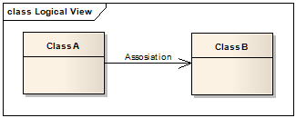
Association

Slide 4
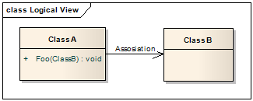
Weak Association
ClassA may be linked to ClassB in order to show that one of its methods includes parameter of ClassB instance, or returns instance of ClassB.

Slide 5
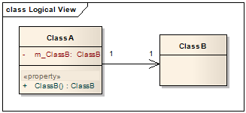
Strong Association
ClassA may also be linked to ClassB in order to show that it holds reference to ClassB instance.

Slide 6
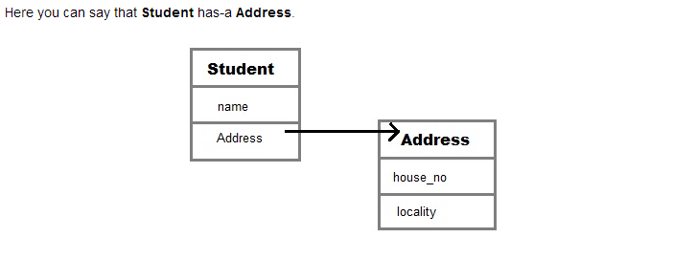
Association Example

Slide 7
Association
Student class has an instance variable of type Address.
Student code can use Address reference to invoke methods on the Address, and get Address behavior.

Slide 8
Association
class Student
{
String name;
Address ad; // reference address class
}
Class Address
{
String house;
……
}

Slide 9
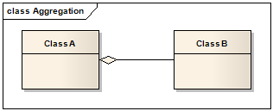
Aggregation (HAS-A)
HAS-A relationship is based on usage, rather than inheritance.
In other words, class A has-a relationship with class B, if code in class A has a reference to an instance of class B

Slide 10
Aggregation
Aggregation allow you to design classes that follow good Object Oriented practices. It also provide code reusability.

Slide 11
Aggregation VS Assoication
The association link can replace the aggregation link in every situation.
while aggregation cannot replace association in situations were there is only a ‘weak link’ between the classes,
i.e. ClassA has method/s that contain parameter of ClassB but ClassA doesn’t hold reference to ClassB instance.

Slide 12
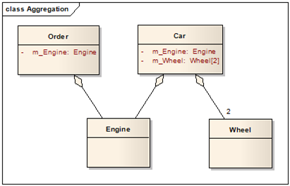
Aggregation Example

Slide 13
Aggregation Example
class Author
{
String authorName;
int age;
String place;
Author(String name,int age,String place)
{
this.authorName=name;
this.age=age;
this.place=place;
}
public String getAuthorName() { return authorName; }
public int getAge() { return age; }
public String getPlace() { return place;}
} // end of class

Slide 14
Aggregation Example
class Book
{
String name;
int price;
Author auth; // reference to author class
Book(String n,int p,Author at)
{
this.name=n;
this.price=p;
this.auth=at;
}
public void showDetail()
{
System.out.println("Book is"+name);
System.out.println("price "+price);
System.out.println("Author is "+auth.getAuthorName());
}
}

Slide 15
Aggregation Example
class Test
{
public static void main(String args[])
{
Author ath=new Author ("Me",22,"India");
Book b=new Book("Java", 550, ath);
Author ath_1 = new Author(“Nabeel”, 17, “Lahore”);
Book b_1 = new Book(“C++”, 1000, ath_1);
b.showDetail();
}
}

Slide 16
Aggregation Example
Output:
Book is Java.
price is 550.
Author is me.

Slide 17
Composition
Composition is restricted form of Aggregation.
For example a class Car cannot exist without Engine.

Slide 18
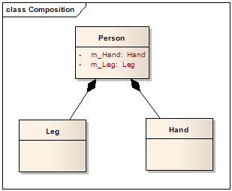
Composition Example

Slide 19
Composition
class Car {
private Engine engine;
Car(Engine en)
{
engine = en;
}
} // end of class car
Class Engine{
// attributes and methods for engine class
}

Slide 20
Composition Example
public class Job {
private String role;
private long salary;
private int id;
public String getRole() { return role; }
public void setRole(String role) { this.role = role; }
public long getSalary() { return salary; }
public void setSalary(long salary) { this.salary = salary; }
public int getId() { return id; }
public void setId(int id) { this.id = id; }
}

Slide 21
Composition Example
public class Person {
private Job job; //composition has-a relationship
public Person(){
job=new Job();
job.setSalary(1000L);
}
public long getSalary() {
return job.getSalary();
}
}

Slide 22
Composition Example
public class TestPerson {
public static void main(String[] args) {
Person person = new Person();
long salary = person.getSalary();
}
}

Slide 23
Inheritance and Aggregation
When to use Inheritance and Aggregation
When you need to use property and behavior of a class without modifying it inside your class. In such case Aggregation is a better option.
Whereas when you need to use and modify property and behavior of a class inside your class, its best to use Inheritance.

